Slide 1
Fundamentals of CRE
Chemical Reaction Engineering
By
Dr Salah N. Farhan
Senior lecturer. Chem. Eng. Dept.
College of Engineering
University of Diyala
Salah N. Farhan College of Engineering Diyala University

Slide 2
Fundamentals of CRE
Chapter 3: Rate Laws
Learning Resources
Summary Notes
Part 1: Rate Laws
Relative Rates of Reaction
Power Law Model
Rate Constant, k
Elementary Reactions
Non-Elementary Rate Laws
Reversible Reactions
Salah N. Farhan College of Engineering Diyala University

Slide 3
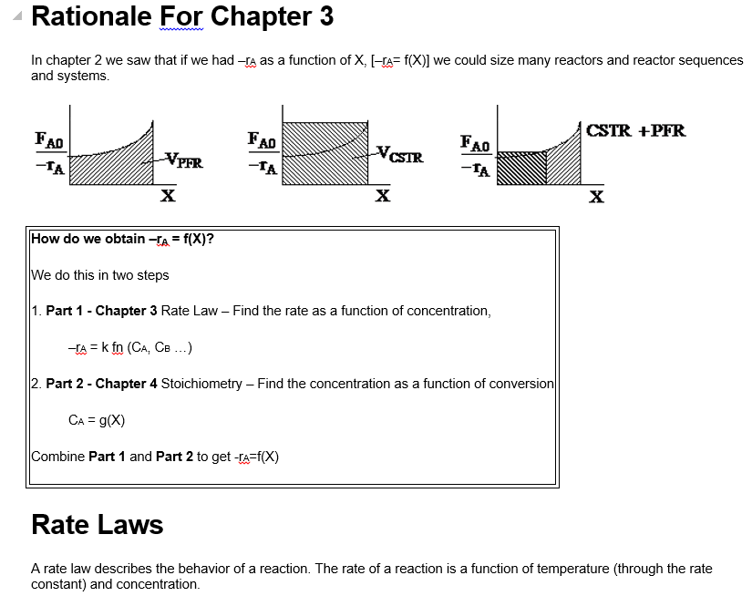
Fundamentals of CRE
Salah N. Farhan College of Engineering Diyala University

Slide 4
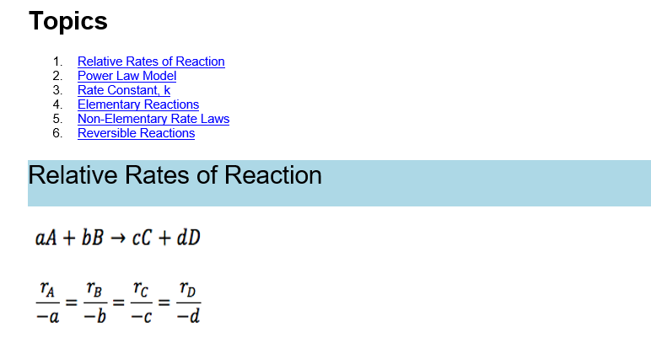
Fundamentals of CRE
Salah N. Farhan College of Engineering Diyala University

Slide 5
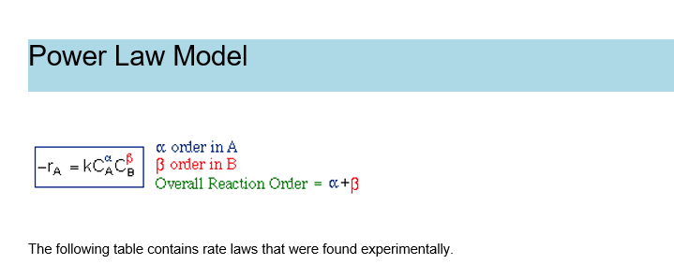
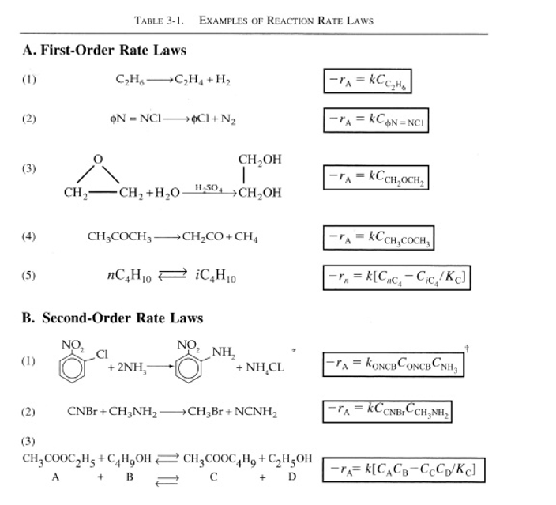
Fundamentals of CRE
Salah N. Farhan College of Engineering Diyala University

Slide 6
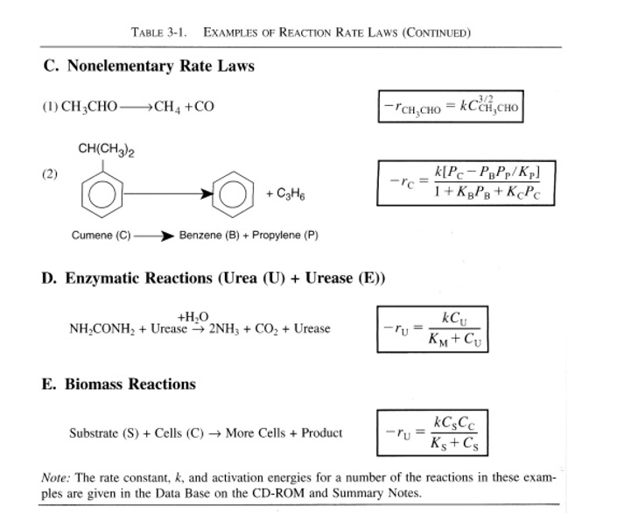
Fundamentals of CRE
Salah N. Farhan College of Engineering Diyala University

Slide 7
Fundamentals of CRE
Salah N. Farhan College of Engineering Diyala University

Slide 8
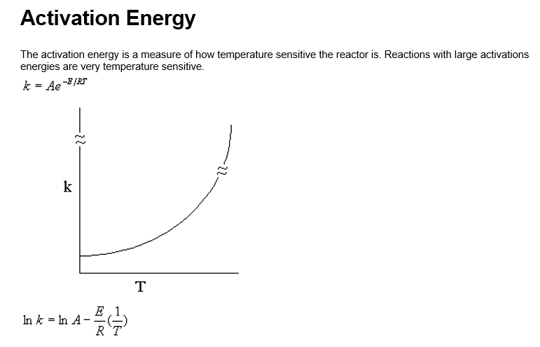
Fundamentals of CRE
Salah N. Farhan College of Engineering Diyala University

Slide 9
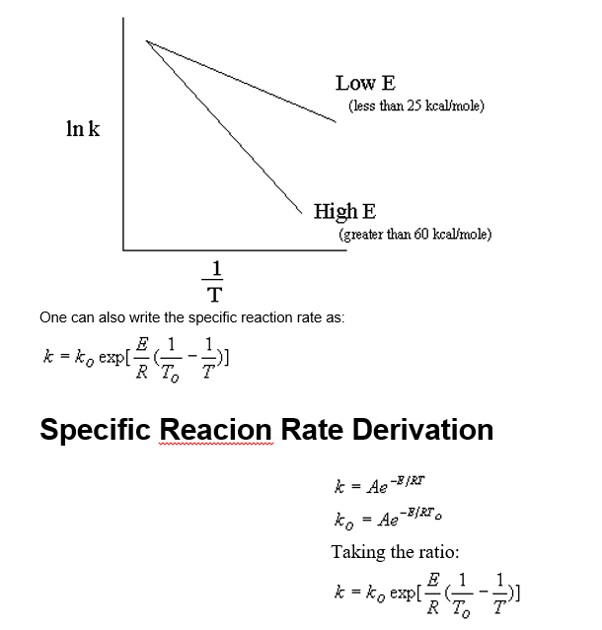
Fundamentals of CRE
Salah N. Farhan College of Engineering Diyala University

Slide 10
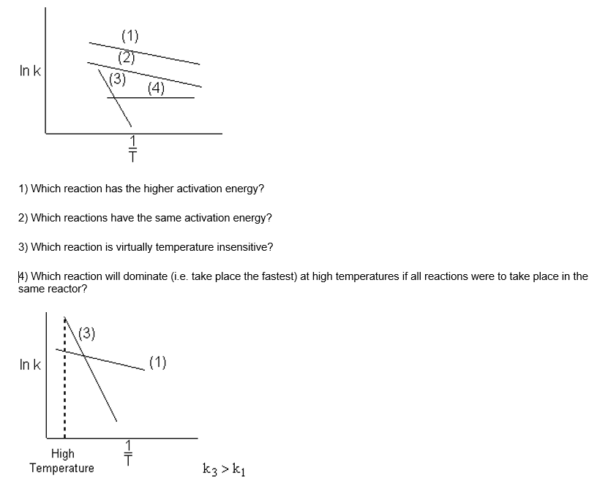
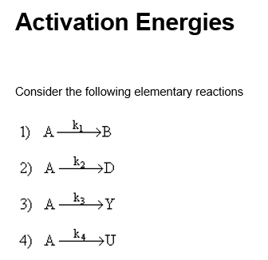
Fundamentals of CRE
Salah N. Farhan College of Engineering Diyala University

Slide 11
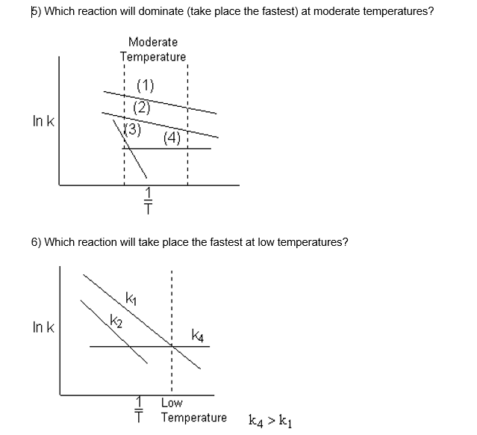
Fundamentals of CRE
7) Which reactions will have the same rate of reaction at a given temperature?
Salah N. Farhan College of Engineering Diyala University

Slide 12
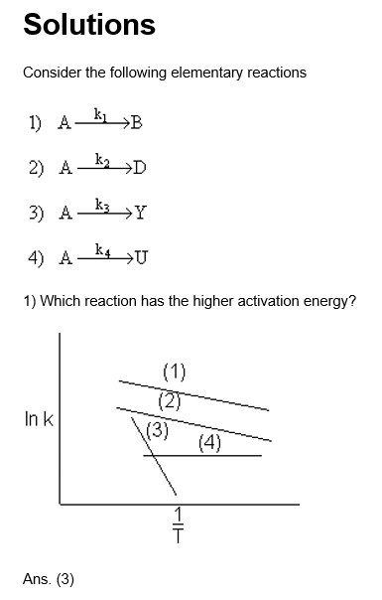
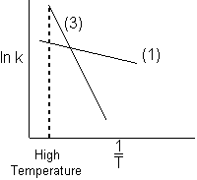
Fundamentals of CRE
2) Which reactions have the same activation energy?
Ans. (1) and (2) – Slope (–E/R) is the same.
3) Which reaction is virtually temperature insensitive?
Ans. (4). k₄ does not vary with temperature E₄ = 0.
4) Which reaction will dominate (i.e. take place the fastest) at high temperatures?
At high temperatures (1/T) is small and k₃ becomes larger than k₁.
Ans. (3)
Salah N. Farhan College of Engineering Diyala University

Slide 13
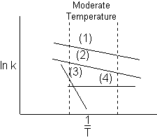
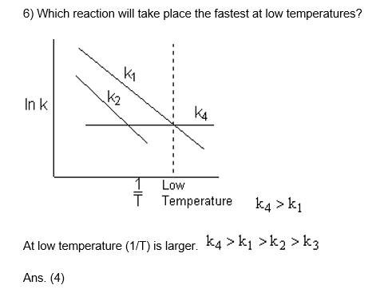
Fundamentals of CRE
5) Which reaction will dominate (take place the fastest) at moderate temperatures?
At moderate temperatures
As. (1)
Salah N. Farhan College of Engineering Diyala University

Slide 14
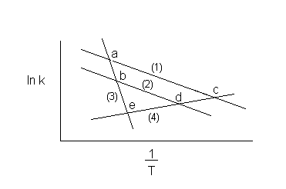
Fundamentals of CRE
7) Which reactions will have the same rate of reaction at a given temperature?
Ans. The rate will be the same when the lines cross.
a. (1) and (3)
b. (2) and (3)
c. (1) and (4)
d. (2) and (4)
e. (3) and (4)
The activation energy is a measure of the minimum energy a that the reacting
molecules must have in order for the reaction to occur.
Salah N. Farhan College of Engineering Diyala University

Slide 15
Fundamentals of CRE
Salah N. Farhan College of Engineering Diyala University

